Slide 1
Chapter 12 File Management
Operating Systems: Internals and Design Principles
Seventh Edition
By William Stallings
Notes:
“Operating Systems: Internal and Design Principles”, 7/e, by William Stallings, Chapter 12 “File Management”.
‹#›

Slide 2

Operating Systems: Internals and Design Principles
If there is one singular characteristic that makes squirrels unique among small mammals it is their natural instinct to hoard food. Squirrels have developed sophisticated capabilities in their hoarding. Different types of food are stored in different ways to maintain quality. Mushrooms, for instance, are usually dried before storing. This is done by impaling them on branches or leaving them in the forks of trees for later retrieval. Pine cones, on the other hand, are often harvested while green and cached in damp conditions that keep seeds from ripening. Gray squirrels usually strip outer husks from walnuts before storing.
— SQUIRRELS: A WILDLIFE HANDBOOK,
Kim Long
Notes:
In most applications, the file is the central element. With the exception of real-time
applications and some other specialized applications, the input to the application is
by means of a file; and in virtually all applications, output is saved in a file for long term
storage and for later access by the user and by other programs.
Files have a life outside of any individual application that uses them for input
and/or output. Users wish to be able to access files, save them, and maintain the
integrity of their contents. To aid in these objectives, virtually all operating systems
provide file management systems. Typically, a file management system consists of
system utility programs that run as privileged applications. However, at the very
least, a file management system needs special services from the operating system;
at the most, the entire file management system is considered part of the operating
system. Thus, it is appropriate to consider the basic elements of file management in
this book.
We begin with an overview, followed by a look at various file organization
schemes. Although file organization is generally beyond the scope of the operating
system, it is essential to have a general understanding of the common alternatives to
appreciate some of the design trade-offs involved in file management. The remainder
of this chapter looks at other topics in file management.
‹#›

Slide 3
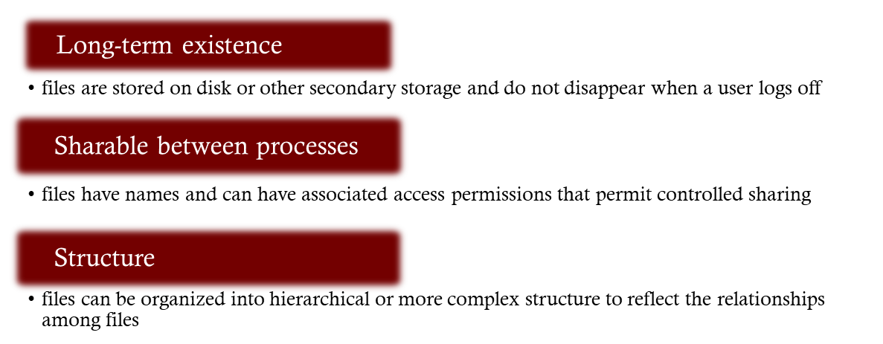
Files
Data collections created by users
The File System is one of the most important parts of the OS to a user
Desirable properties of files:
Notes:
From the user’s point of view, one of the most important parts of an operating
system is the file system. The file system provides the resource abstractions typically
associated with secondary storage. The file system permits users to create data
collections, called files, with desirable properties, such as:
• Long-term existence: Files are stored on disk or other secondary storage and
do not disappear when a user logs off.
• Sharable between processes: Files have names and can have associated access
permissions that permit controlled sharing.
• Structure: Depending on the file system, a file can have an internal structure
that is convenient for particular applications. In addition, files can be organized
into hierarchical or more complex structure to reflect the relationships
among files.
‹#›

Slide 4

File Systems
Provide a means to store data organized as files as well as a collection of functions that can be performed on files
Maintain a set of attributes associated with the file
Typical operations include:
Create
Delete
Open
Close
Read
Write
Notes:
Any file system provides not only a means to store data organized as files, but
a collection of functions that can be performed on files. Typical operations include
the following:
• Create: A new file is defined and positioned within the structure of files.
• Delete: A file is removed from the file structure and destroyed.
• Open: An existing file is declared to be “opened” by a process, allowing the
process to perform functions on the file.
• Close: The file is closed with respect to a process, so that the process no longer
may perform functions on the file, until the process opens the file again.
• Read: A process reads all or a portion of the data in a file.
• Write: A process updates a file, either by adding new data that expands the
size of the file or by changing the values of existing data items in the file.
Typically, a file system maintains a set of attributes associated with the file.
These include owner, creation time, time last modified, access privileges, and so on.
‹#›

Slide 5
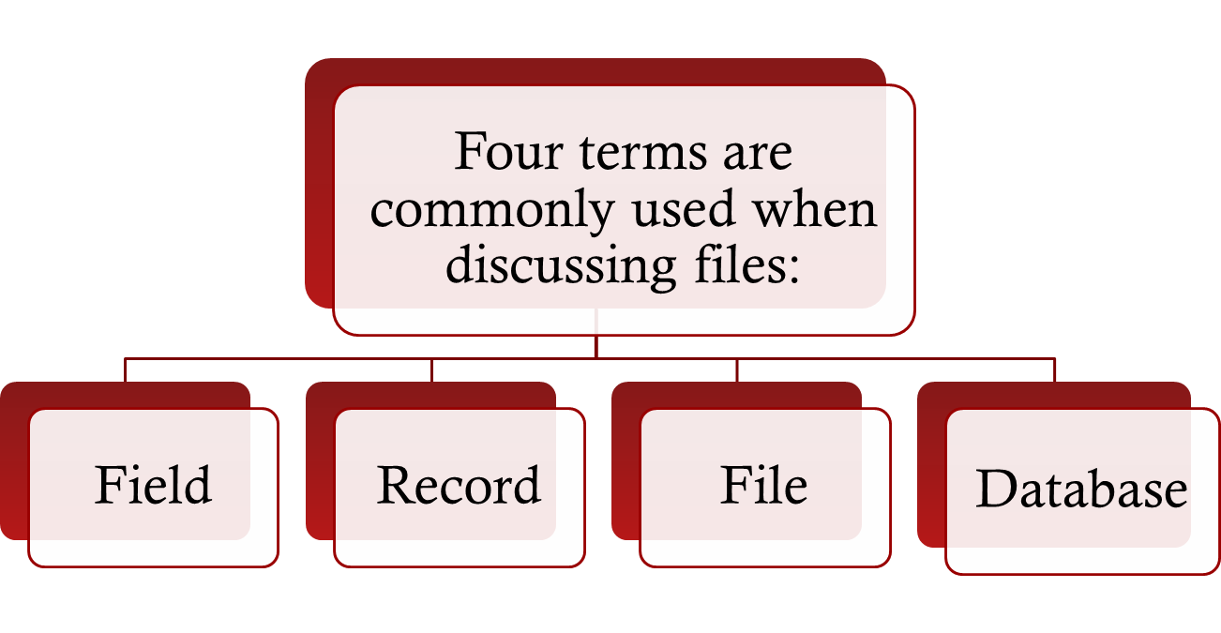
File Structure
Notes:
Four terms are in common use when discussing files:
• Field
• Record
• File
• Database
‹#›

Slide 6
File Structure
Files can be structured as a collection of records or as a sequence of bytes
UNIX, Linux, Windows, Mac OS’s consider files as a sequence of bytes
Other OS’s, notably many IBM mainframes, adopt the collection-of-records approach; useful for DB
COBOL supports the collection-of-records file and can implement it even on systems that don’t provide such files natively.

Slide 7
Structure Terms
Field
File
basic element of data
contains a single value
fixed or variable length
collection of similar records
treated as a single entity
may be referenced by name
access control restrictions usually apply at the file level
Database
collection of related data
relationships among elements of data are explicit
designed for use by a number of different applications
consists of one or more types of files
Record
collection of related fields that can be treated as a unit by some application program
One field is the key – a unique identifier
Notes:
A field is the basic element of data. An individual field contains a single value,
such as an employee’s last name, a date, or the value of a sensor reading. It is characterized
by its length and data type (e.g., ASCII string, decimal). Depending on the
file design, fields may be fixed length or variable length. In the latter case, the field
often consists of two or three subfields: the actual value to be stored, the name of
the field, and, in some cases, the length of the field. In other cases of variable-length
fields, the length of the field is indicated by the use of special demarcation symbols
between fields.
A record is a collection of related fields that can be treated as a unit by some
application program. For example, an employee record would contain such fields
as name, social security number, job classification, date of hire, and so on. Again,
depending on design, records may be of fixed length or variable length. A record
will be of variable length if some of its fields are of variable length or if the number
of fields may vary. In the latter case, each field is usually accompanied by a field
name. In either case, the entire record usually includes a length field.
A file is a collection of similar records. The file is treated as a single entity by
users and applications and may be referenced by name. Files have file names and
may be created and deleted. Access control restrictions usually apply at the file
level. That is, in a shared system, users and programs are granted or denied access
to entire files. In some more sophisticated systems, such controls are enforced at the
record or even the field level.
Some file systems are structured only in terms of fields, not records. In that
case, a file is a collection of fields.
A database is a collection of related data. The essential aspects of a database
are that the relationships that exist among elements of data are explicit and that the
database is designed for use by a number of different applications. A database may
contain all of the information related to an organization or project, such as a business
or a scientific study. The database itself consists of one or more types of files. Usually,
there is a separate database management system that is independent of the operating
system, although that system may make use of some file management programs.
‹#›

Slide 8
File Management System Objectives
Meet the data management needs of the user
Guarantee that the data in the file are valid
Optimize performance
Provide I/O support for a variety of storage device types
Minimize the potential for lost or destroyed data
Provide a standardized set of I/O interface routines to user processes
Provide I/O support for multiple users in the case of multiple-user systems
Notes:
A file management system is that set of system software that provides services to
users and applications in the use of files. Typically, the only way that a user or application
may access files is through the file management system. This relieves the user
or programmer of the necessity of developing special-purpose software for each
application and provides the system with a consistent, well-defined means of controlling
its most important asset. [GROS86] suggests the following objectives for a
file management system:
• To meet the data management needs and requirements of the user, which include
storage of data and the ability to perform the aforementioned operations
• To guarantee, to the extent possible, that the data in the file are valid
• To optimize performance, both from the system point of view in terms of
overall throughput and from the user’s point of view in terms of response time
• To provide I/O support for a variety of storage device types
• To minimize or eliminate the potential for lost or destroyed data
• To provide a standardized set of I/O interface routines to user processes
• To provide I/O support for multiple users, in the case of multiple-user systems
‹#›

Slide 9
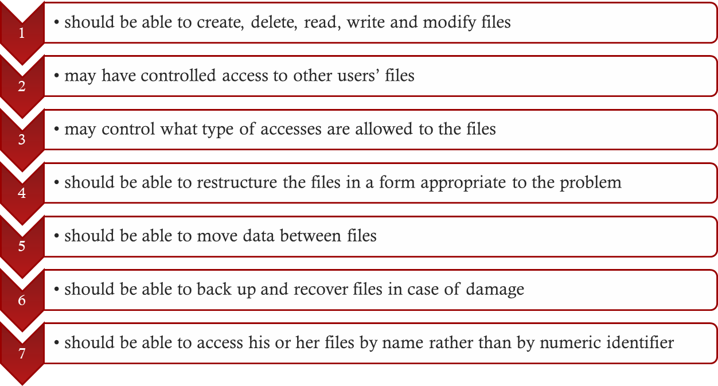
Minimal User Requirements
Each user:
Notes:
With respect to the first point, meeting user requirements, the extent of such
requirements depends on the variety of applications and the environment in which
the computer system will be used. For an interactive, general-purpose system, the
following constitute a minimal set of requirements:
1. Each user should be able to create, delete, read, write, and modify files.
2. Each user may have controlled access to other users’ files.
3. Each user may control what types of accesses are allowed to the user’s files.
4. Each user should be able to restructure the user’s files in a form appropriate to
the problem.
5. Each user should be able to move data between files.
6. Each user should be able to back up and recover the user’s files in case of
damage.
7. Each user should be able to access his or her files by name rather than by
numeric identifier.
These objectives and requirements should be kept in mind throughout our discussion
of file management systems.
‹#›

Slide 10
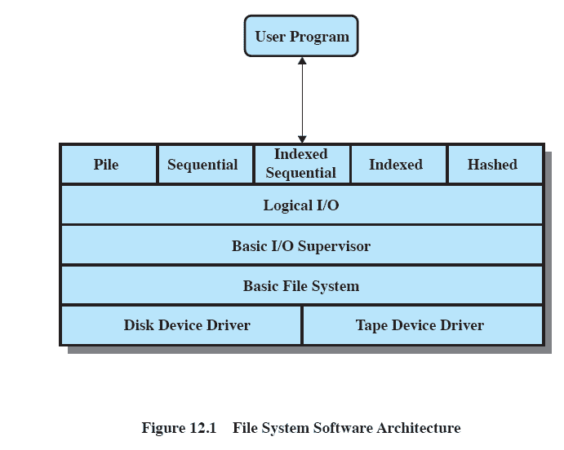
Typical Software Organization
Access methods
Deals with file records
Scheduling , File Status , selects device on which IO
to be performed , IO buffers
Block of data and
exchange with
disk or tape
Notes:
One way of getting a feel for the scope of file
management is to look at a depiction of a typical software organization, as suggested
in Figure 12.1 . Of course, different systems will be organized differently, but this
organization is reasonably representative.
‹#›

Slide 11
File System Architecture
Notice that the top layer consists of a number of different file formats: pile, sequential, indexed sequential, …
These file formats are consistent with the collection-of- records approach to files and determine how file data is accessed
Even in a byte-stream oriented file system it’s possible to build files with record-based structures but it’s up to the application to design the files and build in access methods, indexes, etc.
Operating systems that include a variety of file formats provide access methods and other support automatically.

Slide 12
Layered File System Architecture
File Formats – Access methods provide the interface to users
Logical I/O
Basic I/O
Basic file system
Device drivers

Slide 13

Device Drivers
Lowest level
Communicates directly with peripheral devices
Responsible for starting I/O operations on a device
Processes the completion of an I/O request
Considered to be part of the operating system
Notes:
At the lowest level, device drivers
communicate directly with peripheral devices or their controllers or channels. A
device driver is responsible for starting I/O operations on a device and processing
the completion of an I/O request. For file operations, the typical devices controlled
are disk and tape drives. Device drivers are usually considered to be part of the
operating system.
‹#›

Slide 14

Basic File System
Also referred to as the physical I/O level
Primary interface with the environment outside the computer system
Deals with blocks of data that are exchanged with disk or other mass storage devices.
placement of blocks on the secondary storage device
buffering blocks in main memory
Considered part of the operating system
Notes:
The next level is referred to as the basic file system , or the physical I/O level.
This is the primary interface with the environment outside of the computer system.
It deals with blocks of data that are exchanged with disk or tape systems. Thus, it is
concerned with the placement of those blocks on the secondary storage device and
on the buffering of those blocks in main memory. It does not understand the content
of the data or the structure of the files involved. The basic file system is often
considered part of the operating system.
‹#›

Slide 15

Basic I/O Supervisor
Responsible for all file I/O initiation and termination
Control structures that deal with device I/O, scheduling, and file status are maintained
Selects the device on which I/O is to be performed
Concerned with scheduling disk and tape accesses to optimize performance
I/O buffers are assigned and secondary memory is allocated at this level
Part of the operating system
Notes:
The basic I/O supervisor is responsible for all file I/O initiation and termination.
At this level, control structures are maintained that deal with device I/O,
scheduling, and file status. The basic I/O supervisor selects the device on which file
I/O is to be performed, based on the particular file selected. It is also concerned
with scheduling disk and tape accesses to optimize performance. I/O buffers are
assigned and secondary memory is allocated at this level. The basic I/O supervisor is
part of the operating system.
‹#›

Slide 16
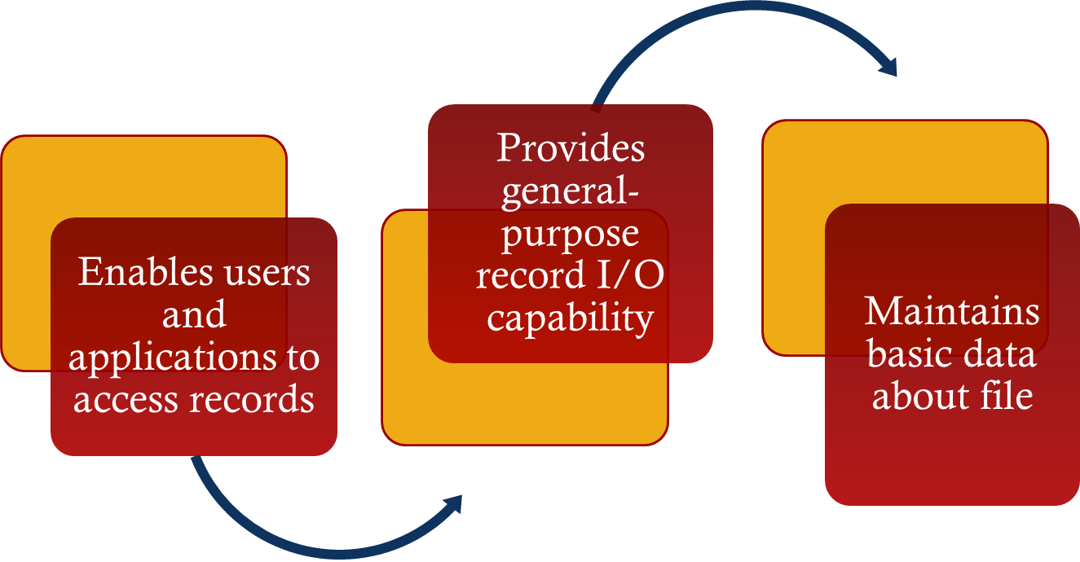
Logical I/O
Notes:
Logical I/O enables users and applications to access records. Thus, whereas
the basic file system deals with blocks of data, the logical I/O module deals with file
records. Logical I/O provides a general-purpose record I/O capability and maintains
basic data about files.
‹#›

Slide 17
Logical I/O
This level is the interface between the
logical commands issued by a program and the physical details required by the disk.
Logical units of data versus physical blocks of data to match disk requirements.
Notes:
Logical I/O enables users and applications to access records. Thus, whereas
the basic file system deals with blocks of data, the logical I/O module deals with file
records. Logical I/O provides a general-purpose record I/O capability and maintains
basic data about files.
‹#›

Slide 18

Access Method
Level of the file system closest to the user
Provides a standard interface between applications and the file systems and devices that hold the data
Different access methods reflect different file structures and different ways of accessing and processing the data
Notes:
The level of the file system closest to the user is often termed the access
method . It provides a standard interface between applications and the file systems
and devices that hold the data. Different access methods reflect different file structures
and different ways of accessing and processing the data. Some of the most
common access methods are shown in Figure 12.1 , and these are briefly described
in Section 12.2 .
‹#›

Slide 19
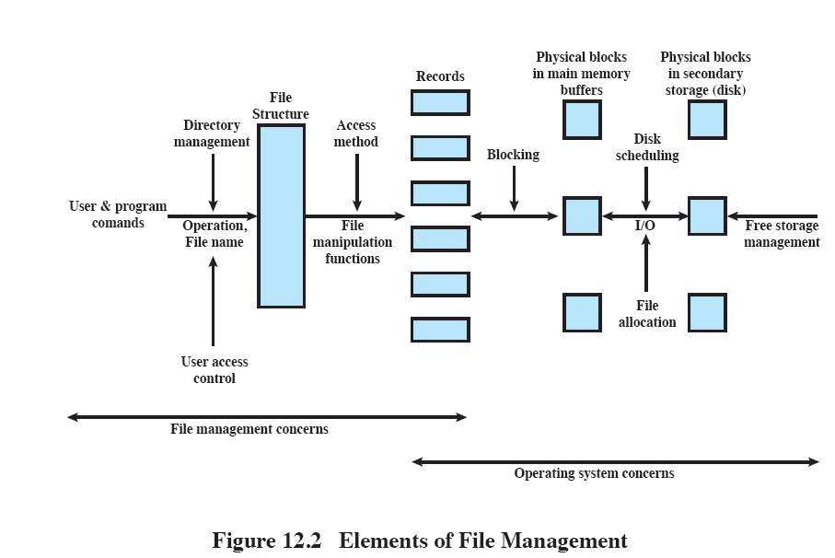
Elements of File Management
Notes:
Another way of viewing the functions of a file
system is shown in Figure 12.2 . Let us follow this diagram from left to right. Users
and application programs interact with the file system by means of commands for
creating and deleting files and for performing operations on files. Before performing
any operation, the file system must identify and locate the selected file. This requires
the use of some sort of directory that serves to describe the location of all files, plus
their attributes. In addition, most shared systems enforce user access control: Only
authorized users are allowed to access particular files in particular ways. The basic
operations that a user or application may perform on a file are performed at the
record level. The user or application views the file as having some structure that
organizes the records, such as a sequential structure (e.g., personnel records are
stored alphabetically by last name). Thus, to translate user commands into specific
file manipulation commands, the access method appropriate to this file structure
must be employed.
Whereas users and applications are concerned with records or fields, I/O is
done on a block basis. Thus, the records or fields of a file must be organized as a
sequence of blocks for output and unblocked after input. To support block I/O of
files, several functions are needed. The secondary storage must be managed. This
involves allocating files to free blocks on secondary storage and managing free storage
so as to know what blocks are available for new files and growth in existing files.
In addition, individual block I/O requests must be scheduled; this issue was dealt with
in Chapter 11 . Both disk scheduling and file allocation are concerned with optimizing
performance. As might be expected, these functions therefore need to be considered
together. Furthermore, the optimization will depend on the structure of the files and
the access patterns. Accordingly, developing an optimum file management system
from the point of view of performance is an exceedingly complicated task.
Figure 12.2 suggests a division between what might be considered the concerns
of the file management system as a separate system utility and the concerns
of the operating system, with the point of intersection being record processing. This
division is arbitrary; various approaches are taken in various systems.
In the remainder of this chapter, we look at some of the design issues suggested
in Figure 12.2 . We begin with a discussion of file organizations and access
methods. Although this topic is beyond the scope of what is usually considered the
concerns of the operating system, it is impossible to assess the other file-related
design issues without an appreciation of file organization and access. Next, we look
at the concept of file directories. These are often managed by the operating system
on behalf of the file management system. The remaining topics deal with the physical
I/O aspects of file management and are properly treated as aspects of OS design.
One such issue is the way in which logical records are organized into physical blocks.
Finally, there are the related issues of file allocation on secondary storage and the
management of free secondary storage.
‹#›

Slide 20

File Organization and Access
File organization is the logical structuring of the records as determined by the way in which they are accessed
In choosing a file organization, several criteria are important:
short access time
ease of update
economy of storage
simple maintenance
reliability
Priority of criteria depends on the application that will use the file
Notes:
In this section, we use the term file organization to refer to the logical structuring
of the records as determined by the way in which they are accessed. The physical
organization of the file on secondary storage depends on the blocking strategy and
the file allocation strategy, issues dealt with later in this chapter.
In choosing a file organization, several criteria are important:
• Short access time
• Ease of update
• Economy of storage
• Simple maintenance
• Reliability
The relative priority of these criteria will depend on the applications that will
use the file. For example, if a file is only to be processed in batch mode, with all of
the records accessed every time, then rapid access for retrieval of a single record is
of minimal concern. A file stored on CD-ROM will never be updated, and so ease
of update is not an issue.
These criteria may conflict. For example, for economy of storage, there should be
minimum redundancy in the data. On the other hand, redundancy is a primary means
of increasing the speed of access to data. An example of this is the use of indexes.
‹#›

Slide 21
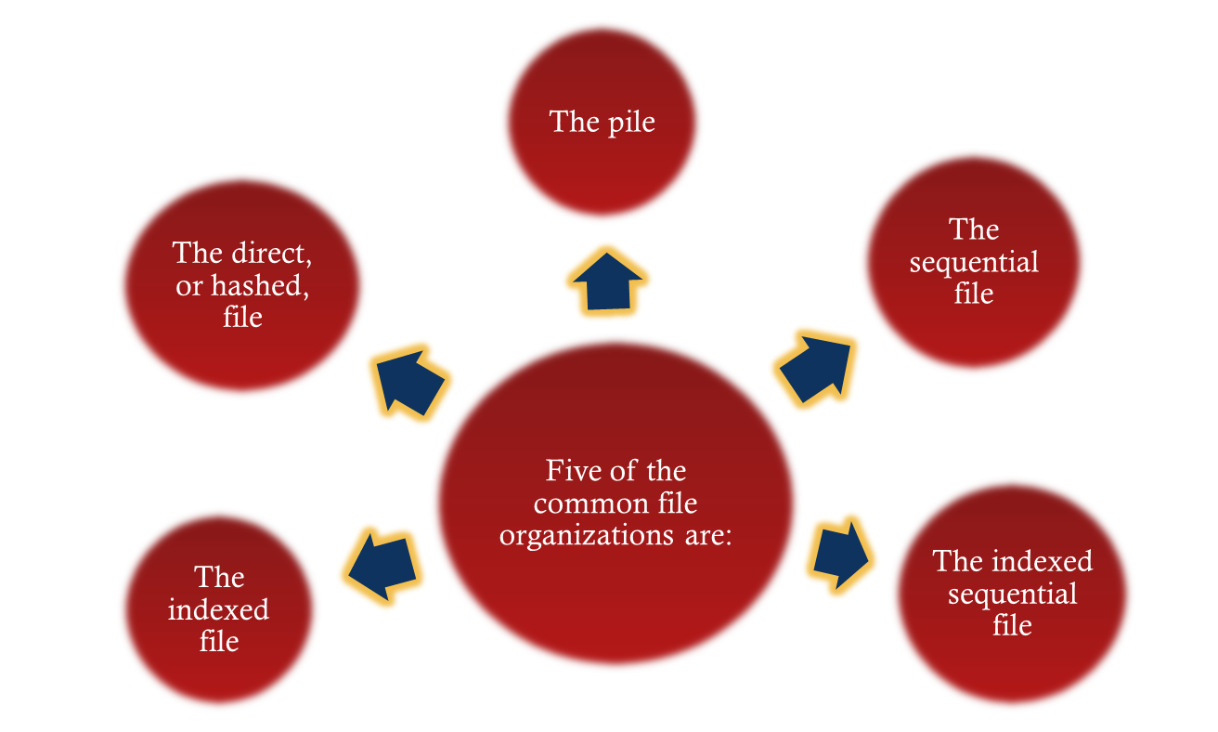
File Organization Types
Notes:
The number of alternative file organizations that have been implemented or
just proposed is unmanageably large, even for a book devoted to file systems. In this
brief survey, we will outline five fundamental organizations. Most structures used in
actual systems either fall into one of these categories or can be implemented with a
combination of these organizations. The five organizations, the first four of which
are depicted in Figure 12.3 , are as follows:
The pile
• The sequential file
• The indexed sequential file
• The indexed file
• The direct, or hashed, file
‹#›

Slide 22
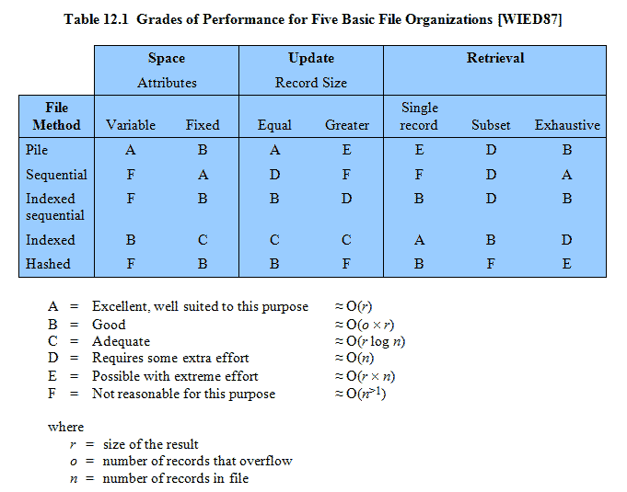

Grades of Performance
Notes:
Table 12.1 summarizes relative performance aspects of these five organizations.
‹#›

Slide 23
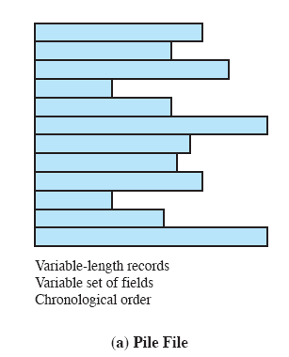
The Pile
Least complicated form of file organization
Data are collected in the order they arrive
Each record consists of one burst of data
Purpose is simply to accumulate the mass of data and save it
Record access is by exhaustive search
Notes:
The least-complicated form of file organization may be termed the pile . Data are
collected in the order in which they arrive. Each record consists of one burst of
data. The purpose of the pile is simply to accumulate the mass of data and save it.
Records may have different fields, or similar fields in different orders. Thus, each
field should be self-describing, including a field name as well as a value. The length
of each field must be implicitly indicated by delimiters, explicitly included as a subfield,
or known as default for that field type.
Because there is no structure to the pile file, record access is by exhaustive
search. That is, if we wish to find a record that contains a particular field with a
particular value, it is necessary to examine each record in the pile until the desired
record is found or the entire file has been searched. If we wish to find all records
that contain a particular field or contain that field with a particular value, then the
entire file must be searched.
Pile files are encountered when data are collected and stored prior to processing
or when data are not easy to organize. This type of file uses space well when the
stored data vary in size and structure, is perfectly adequate for exhaustive searches,
and is easy to update. However, beyond these limited uses, this type of file is unsuitable
for most applications.
‹#›

Slide 24
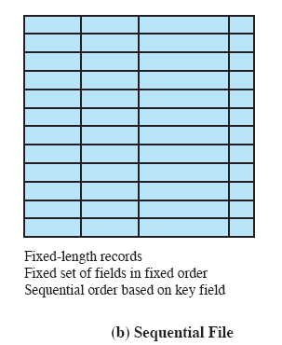
The Sequential File
Most common form of file structure
A fixed format is used for records
Key field uniquely identifies the record & determines storage order
Typically used in batch applications
Only organization that is easily stored on tape as well as disk
Notes:
The most common form of file structure is the sequential file. In this type of file,
a fixed format is used for records. All records are of the same length, consisting of
the same number of fixed-length fields in a particular order. Because the length and
position of each field are known, only the values of fields need to be stored; the field
name and length for each field are attributes of the file structure.
One particular field, usually the first field in each record, is referred to as the
key field . The key field uniquely identifies the record; thus key values for different
records are always different. Further, the records are stored in key sequence: alphabetical
order for a text key, and numerical order for a numerical key.
Sequential files are typically used in batch applications and are generally
optimum for such applications if they involve the processing of all the records (e.g.,
a billing or payroll application). The sequential file organization is the only one that
is easily stored on tape as well as disk.
For interactive applications that involve queries and/or updates of individual
records, the sequential file provides poor performance. Access requires the sequential
search of the file for a key match. If the entire file, or a large portion of the
file, can be brought into main memory at one time, more efficient search techniques
are possible. Nevertheless, considerable processing and delay are encountered to
access a record in a large sequential file. Additions to the file also present problems.
Typically, a sequential file is stored in simple sequential ordering of the records within
blocks. That is, the physical organization of the file on tape or disk directly matches
the logical organization of the file. In this case, the usual procedure is to place new
records in a separate pile file, called a log file or transaction file. Periodically, a batch
update is performed that merges the log file with the master file to produce a new file
in correct key sequence.
An alternative is to organize the sequential file physically as a linked list. One
or more records are stored in each physical block. Each block on disk contains a
pointer to the next block. The insertion of new records involves pointer manipulation
but does not require that the new records occupy a particular physical block
position. Thus, some added convenience is obtained at the cost of additional
processing and overhead.
‹#›

Slide 25
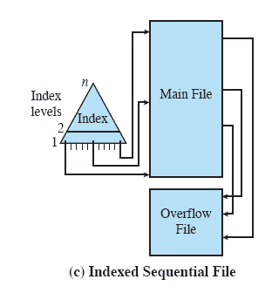
Indexed Sequential File
Adds an index to the file to support random access
Adds an overflow file
Greatly reduces the time required to access a single record
Multiple levels of indexing can be used to provide greater efficiency in access
Notes:
A popular approach to overcoming the disadvantages of the sequential file is the
indexed sequential file. The indexed sequential file maintains the key characteristic
of the sequential file: Records are organized in sequence based on a key field. Two
features are added: an index to the file to support random access, and an overflow
file. The index provides a lookup capability to reach quickly the vicinity of a desired
record. The overflow file is similar to the log file used with a sequential file but is
integrated so that a record in the overflow file is located by following a pointer from
its predecessor record.
In the simplest indexed sequential structure, a single level of indexing is
used. The index in this case is a simple sequential file. Each record in the index file
consists of two fields: a key field, which is the same as the key field in the main file,
and a pointer into the main file. To find a specific field, the index is searched to find
the highest key value that is equal to or precedes the desired key value. The search
continues in the main file at the location indicated by the pointer.
To see the effectiveness of this approach, consider a sequential file with
1 million records. To search for a particular key value will require on average one-half
million record accesses. Now suppose that an index containing 1,000 entries
is constructed, with the keys in the index more or less evenly distributed over
the main file. Now it will take on average 500 accesses to the index file followed
by 500 accesses to the main file to find the record. The average search length is
reduced from 500,000 to 1,000.
Additions to the file are handled in the following manner: Each record in
the main file contains an additional field not visible to the application, which is a
pointer to the overflow file. When a new record is to be inserted into the file, it is
added to the overflow file. The record in the main file that immediately precedes
the new record in logical sequence is updated to contain a pointer to the new record
in the overflow file. If the immediately preceding record is itself in the overflow file,
then the pointer in that record is updated. As with the sequential file, the indexed
sequential file is occasionally merged with the overflow file in batch mode.
The indexed sequential file greatly reduces the time required to access a single
record, without sacrificing the sequential nature of the file. To process the entire file
sequentially, the records of the main file are processed in sequence until a pointer
to the overflow file is found, then accessing continues in the overflow file until a null
pointer is encountered, at which time accessing of the main file is resumed where it
left off.
To provide even greater efficiency in access, multiple levels of indexing can be
used. Thus the lowest level of index file is treated as a sequential file and a higher level
index file is created for that file. Consider again a file with 1 million records.
A lower-level index with 10,000 entries is constructed. A higher-level index into
the lower-level index of 100 entries can then be constructed. The search begins at
the higher-level index (average length = 50 accesses) to find an entry point into the
lower-level index. This index is then searched (average length = 50) to find an entry
point into the main file, which is then searched (average length = 50). Thus the average
length of search has been reduced from 500,000 to 1,000 to 150.
‹#›

Slide 26
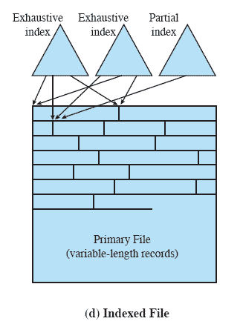
Indexed File
Records are accessed only through their indexes
Variable-length records can be employed
Exhaustive index contains one entry for every record in the main file
Partial index contains entries to records where the field of interest exists
Used mostly in applications where timeliness of information is critical
Examples would be airline reservation systems and inventory control systems
Notes:
The indexed sequential file retains one limitation of the sequential file: Effective
processing is limited to that which is based on a single field of the file. For example,
when it is necessary to search for a record on the basis of some other attribute than
the key field, both forms of sequential file are inadequate. In some applications, the
flexibility of efficiently searching by various attributes is desirable.
To achieve this flexibility, a structure is needed that employs multiple indexes,
one for each type of field that may be the subject of a search. In the general indexed
file, the concept of sequentially and a single key are abandoned. Records are
accessed only through their indexes. The result is that there is now no restriction
on the placement of records as long as a pointer in at least one index refers to that
record. Furthermore, variable-length records can be employed.
Two types of indexes are used. An exhaustive index contains one entry for
every record in the main file. The index itself is organized as a sequential file for
ease of searching. A partial index contains entries to records where the field of
interest exists. With variable-length records, some records will not contain all fields.
When a new record is added to the main file, all of the index files must be updated.
Indexed files are used mostly in applications where timeliness of information
is critical and where data are rarely processed exhaustively. Examples are airline
reservation systems and inventory control systems.
‹#›

Slide 27
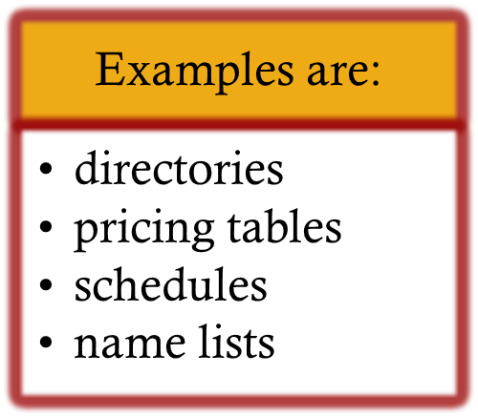
Direct or Hashed File
Access directly any block of a known address
Makes use of hashing on the key value
Often used where:
very rapid access is required
fixed-length records are used
records are always accessed one at a time
Notes:
The direct, or hashed, file exploits the capability found on disks to access directly any
block of a known address. As with sequential and indexed sequential files, a key field
is required in each record. However, there is no concept of sequential ordering here.
The direct file makes use of hashing on the key value. This function is explained
in Appendix F . Figure F.1b shows the type of hashing organization with an overflow
file that is typically used in a hash file.
Direct files are often used where very rapid access is required, where fixed length
records are used, and where records are always accessed one at a time.
Examples are directories, pricing tables, schedules, and name lists.
‹#›

Slide 28


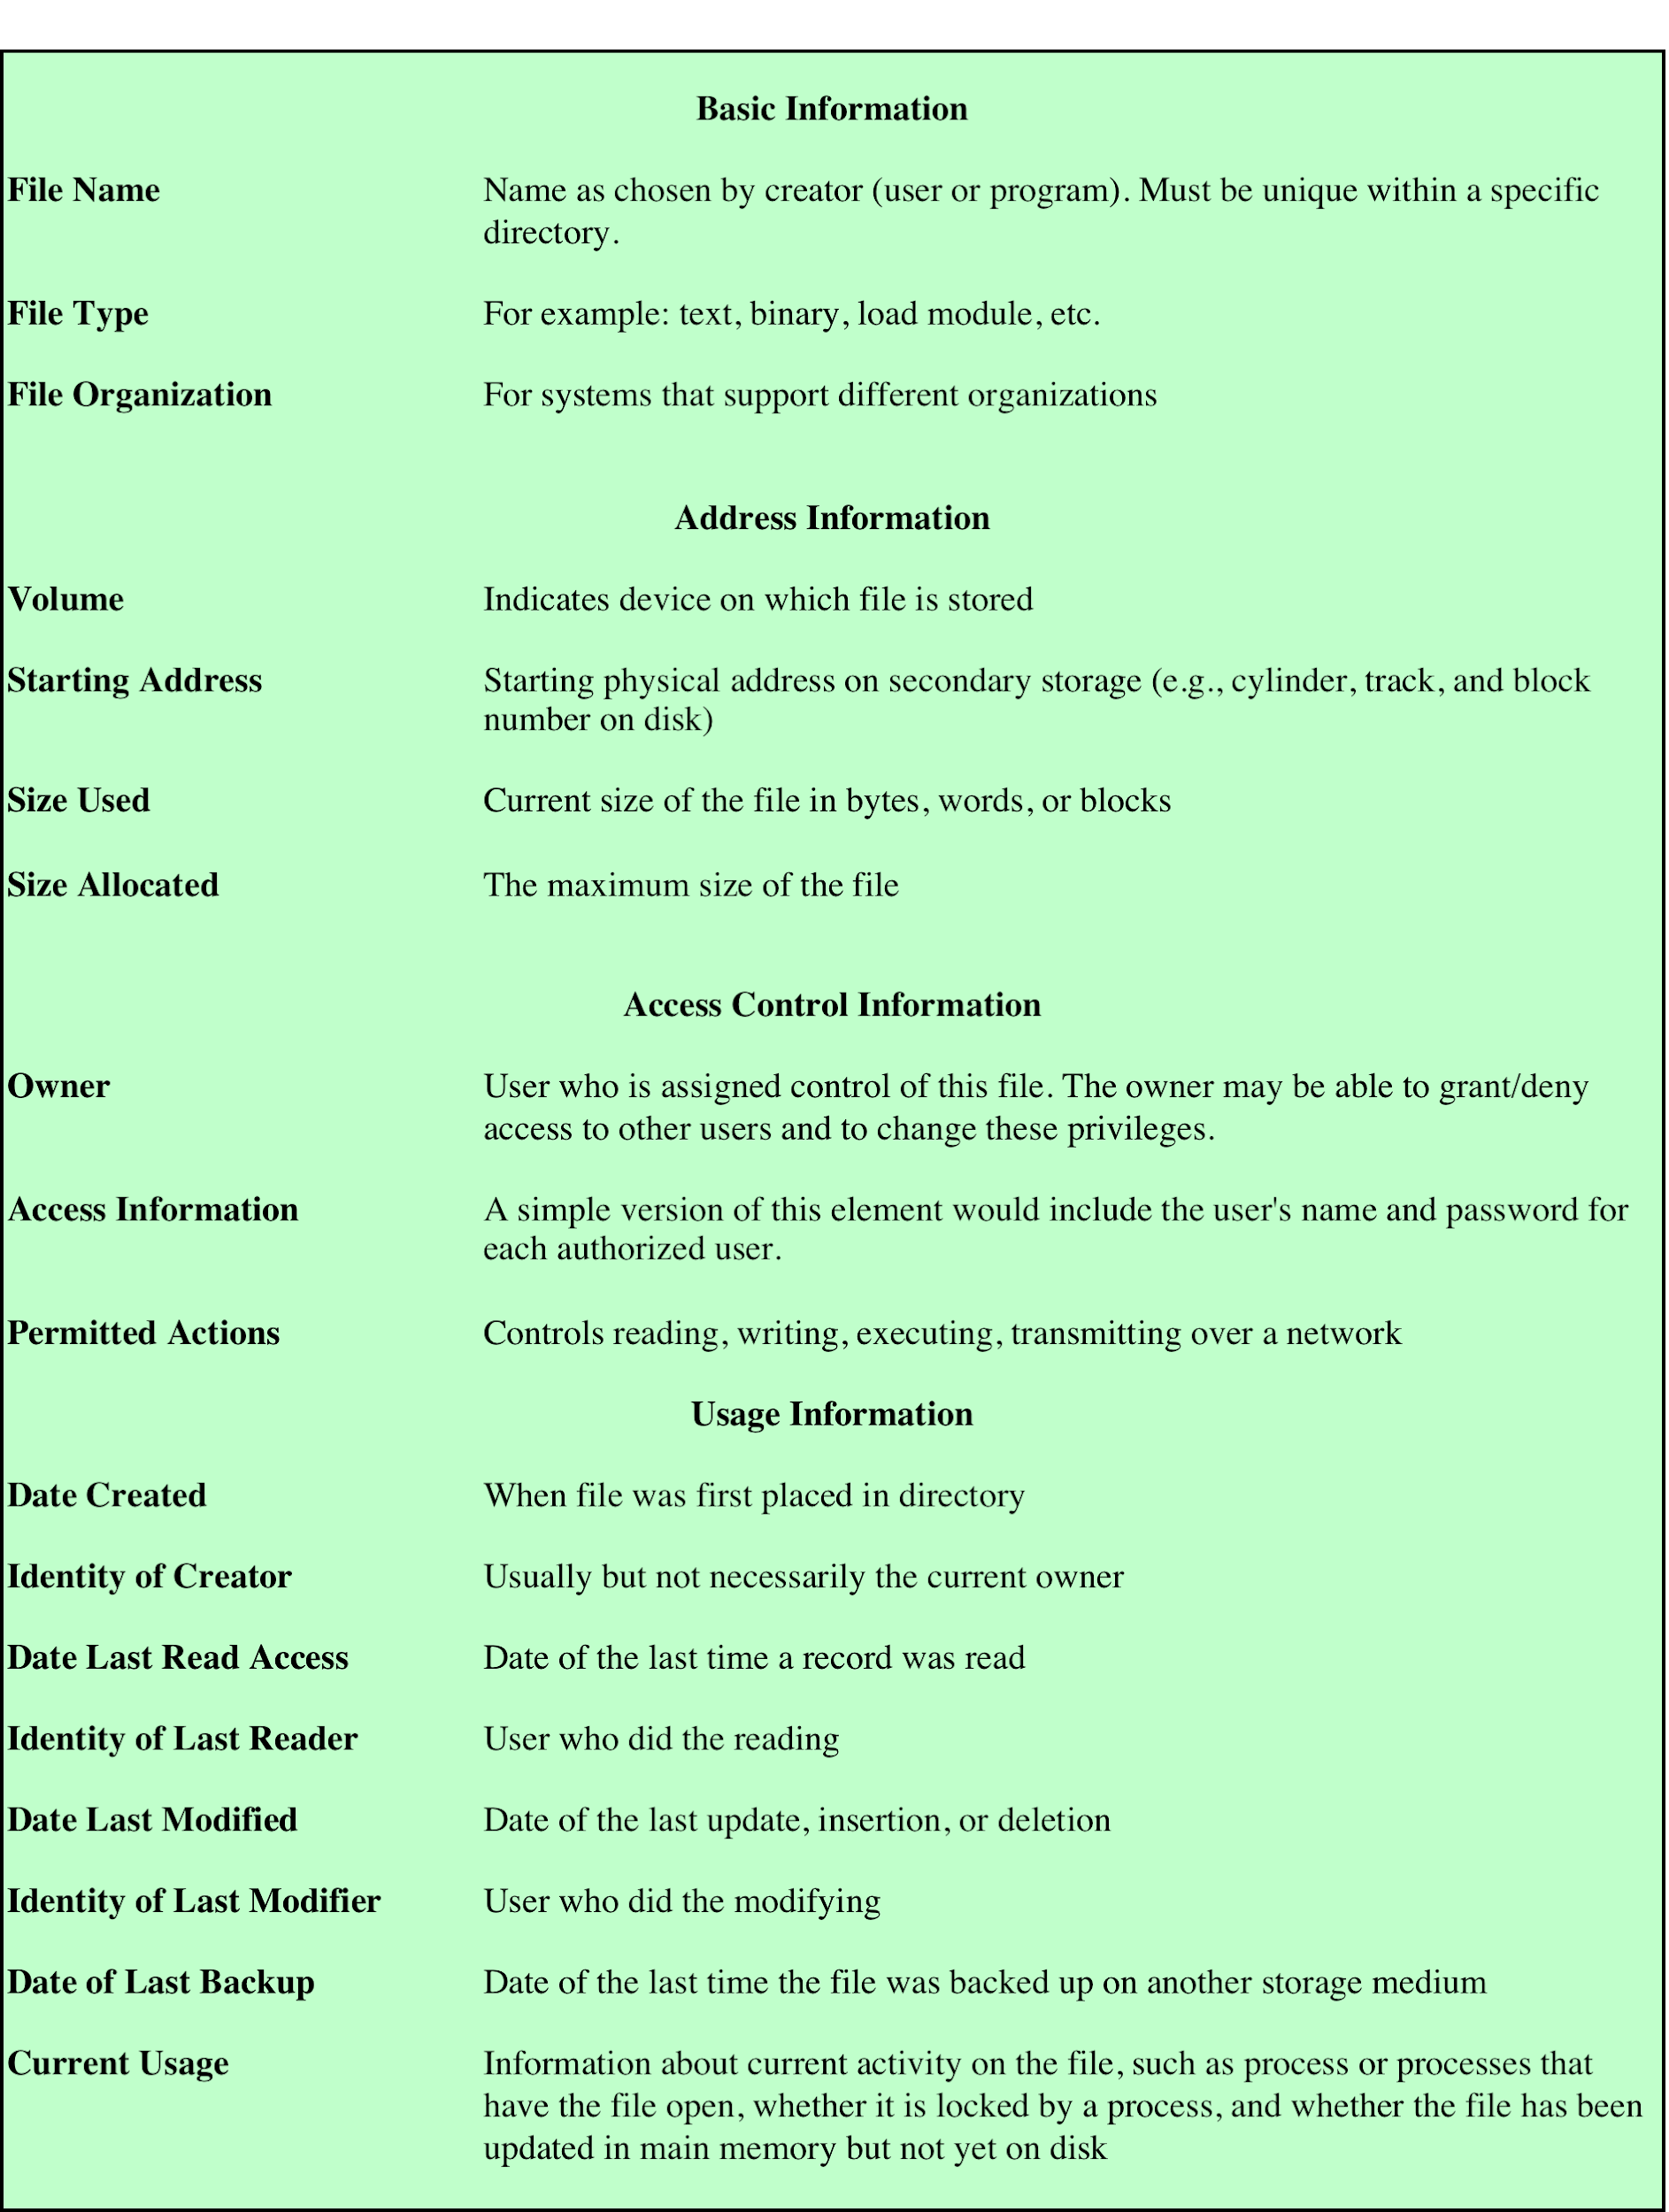
File Directory Information
Table 12.2 Information Elements of a File Directory
Notes:
Associated with any file management system and collection of files is a file directory.
The directory contains information about the files, including attributes, location,
and ownership. Much of this information, especially that concerned with storage,
is managed by the operating system. The directory is itself a file, accessible by various
file management routines. Although some of the information in directories is
available to users and applications, this is generally provided indirectly by system
routines.
Table 12.2 suggests the information typically stored in the directory for each
file in the system. From the user’s point of view, the directory provides a mapping
between file names, known to users and applications, and the files themselves. Thus,
each file entry includes the name of the file. Virtually all systems deal with different
types of files and different file organizations, and this information is also provided.
An important category of information about each file concerns its storage, including
its location and size. In shared systems, it is also important to provide information
that is used to control access to the file. Typically, one user is the owner of the file
and may grant certain access privileges to other users. Finally, usage information is
needed to manage the current use of the file and to record the history of its usage.
‹#›

Slide 29
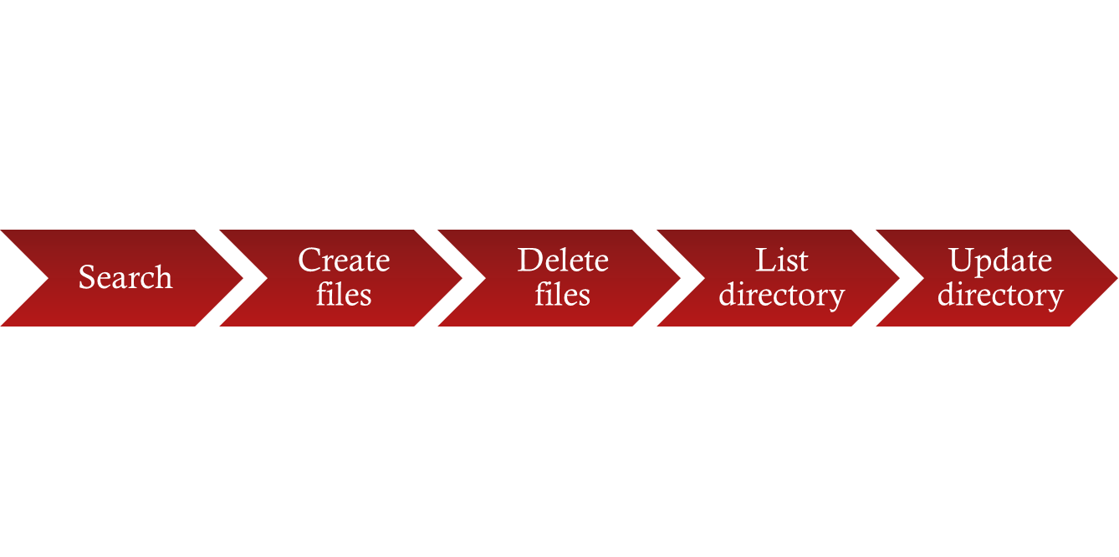

Operations Performed on a Directory
To understand the requirements for a file structure, it is helpful to consider the types of operations that may be performed on the directory:
Notes:
To understand the requirements for a file structure, it is helpful to consider
the types of operations that may be performed on the directory:
• Search: When a user or application references a file, the directory must be
searched to find the entry corresponding to that file.
• Create file: When a new file is created, an entry must be added to the directory.
• Delete file: When a file is deleted, an entry must be removed from the directory.
• List directory: All or a portion of the directory may be requested. Generally,
this request is made by a user and results in a listing of all files owned by that
user, plus some of the attributes of each file (e.g., type, access control information,
usage information).
• Update directory: Because some file attributes are stored in the directory, a
change in one of these attributes requires a change in the corresponding directory
entry.
The simple list is not suited to supporting these operations. Consider the needs
of a single user. The user may have many types of files, including word-processing
text files, graphic files, spreadsheets, and so on. The user may like to have these
organized by project, by type, or in some other convenient way. If the directory is a
simple sequential list, it provides no help in organizing the files and forces the user
to be careful not to use the same name for two different types of files. The problem
is much worse in a shared system. Unique naming becomes a serious problem.
Furthermore, it is difficult to conceal portions of the overall directory from users
when there is no inherent structure in the directory.
‹#›

Slide 30
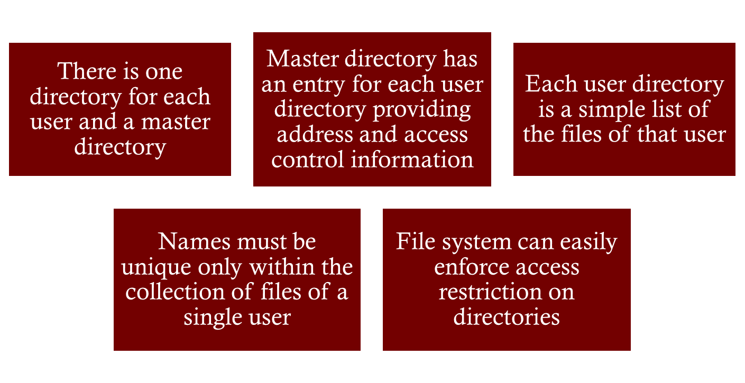
Two-Level Scheme
Notes:
A start in solving these problems would be to go to a two-level scheme. In
this case, there is one directory for each user, and a master directory. The master
directory has an entry for each user directory, providing address and access control
information. Each user directory is a simple list of the files of that user. This
arrangement means that names must be unique only within the collection of files
of a single user and that the file system can easily enforce access restriction on
directories. However, it still provides users with no help in structuring collections
of files.
‹#›

Slide 31
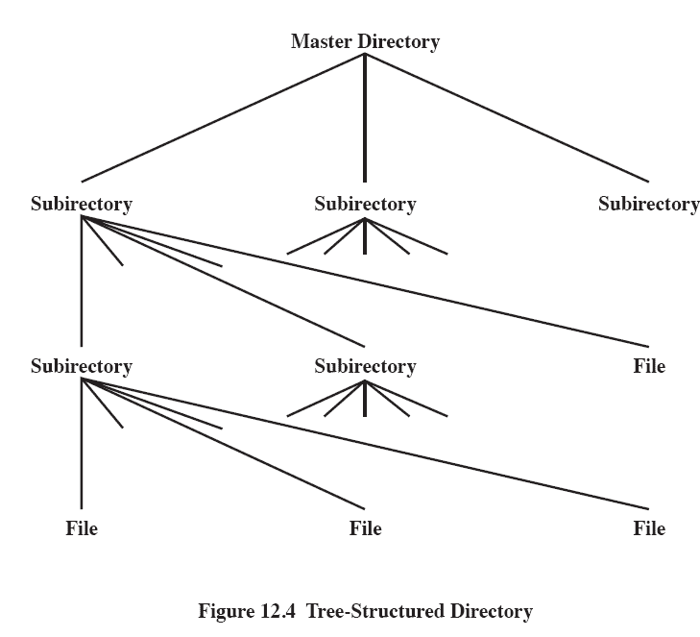
Figure 12.4 Tree-Structured Directory
Master directory with user directories underneath it
Each user directory may have subdirectories and files as entries
Notes:
A more powerful and flexible approach, and one that is almost universally
adopted, is the hierarchical, or tree-structure, approach ( Figure 12.6 ). As before,
there is a master directory, which has under it a number of user directories. Each of
these user directories, in turn, may have subdirectories and files as entries. This is
true at any level: That is, at any level, a directory may consist of entries for subdirectories
and/or entries for files.
It remains to say how each directory and subdirectory is organized. The simplest
approach, of course, is to store each directory as a sequential file. When directories
may contain a very large number of entries, such an organization may lead to unnecessarily
long search times. In that case, a hashed structure is to be preferred.
‹#›

Slide 32
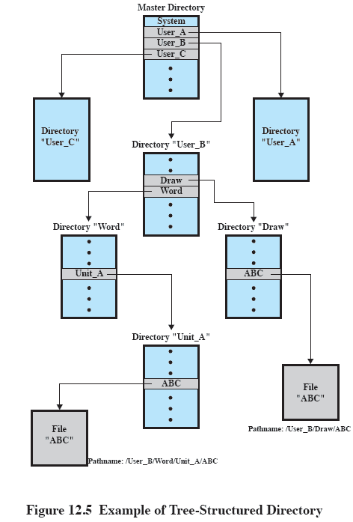

Figure 12.7 Example of Tree-Structured Directory
Notes:
Users need to be able to refer to a file by a symbolic name. Clearly, each file in the
system must have a unique name in order that file references be unambiguous. On
the other hand, it is an unacceptable burden on users to require that they provide
unique names, especially in a shared system.
The use of a tree-structured directory minimizes the difficulty in assigning
unique names. Any file in the system can be located by following a path from the
root or master directory down various branches until the file is reached. The series
of directory names, culminating in the file name itself, constitutes a pathname for
the file. As an example, the file in the lower left-hand corner of Figure 12.7 . has the
pathname User_B/Word/Unit_A/ABC . The slash is used to delimit names in the
sequence. The name of the master directory is implicit, because all paths start at
that directory. Note that it is perfectly acceptable to have several files with the same
file name, as long as they have unique pathnames, which is equivalent to saying
that the same file name may be used in different directories. In our example, there
is another file in the system with the file name ABC, but that has the pathname
/User_B/Draw/ABC .
Although the pathname facilitates the selection of file names, it would be awkward
for a user to have to spell out the entire pathname every time a reference is
made to a file. Typically, an interactive user or a process has associated with it a
current directory, often referred to as the working directory . Files are then referenced
relative to the working directory. For example, if the working directory for
user B is “Word,” then the pathname Unit_A/ABC is sufficient to identify the file
in the lower left-hand corner of Figure 12.7 . When an interactive user logs on, or
when a process is created, the default for the working directory is the user home
directory. During execution, the user can navigate up or down in the tree to change
to a different working directory.
‹#›

Slide 33
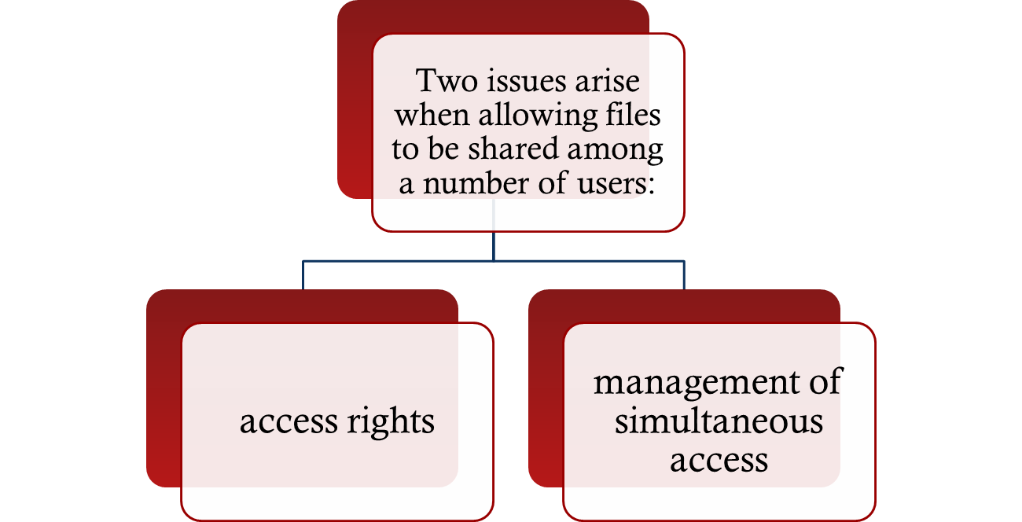

File Sharing
Notes:
In a multiuser system, there is almost always a requirement for allowing files to be
shared among a number of users. Two issues arise: access rights and the management
of simultaneous access.
‹#›

Slide 34

Access Rights
None
the user would not be allowed to read the user directory that includes the file
Knowledge
the user can determine that the file exists and who its owner is and can then petition the owner for additional access rights
Execution
the user can load and execute a program but cannot copy it
Reading
the user can read the file for any purpose, including copying and execution
Appending
the user can add data to the file but cannot modify or delete any of the file’s contents
Updating
the user can modify, delete, and add to the file’s data
Changing protection
the user can change the access rights granted to other users
Deletion
the user can delete the file from the file system
Notes:
The file system should provide a flexible tool for allowing extensive file sharing
among users. The file system should provide a number of options so that the way
in which a particular file is accessed can be controlled. Typically, users or groups
of users are granted certain access rights to a file. A wide range of access rights has
been used. The following list is representative of access rights that can be assigned
to a particular user for a particular file:
• None: The user may not even learn of the existence of the file, much less
access it. To enforce this restriction, the user would not be allowed to read the
user directory that includes this file.
• Knowledge: The user can determine that the file exists and who its owner is.
The user is then able to petition the owner for additional access rights.
• Execution: The user can load and execute a program but cannot copy it.
Proprietary programs are often made accessible with this restriction.
• Reading: The user can read the file for any purpose, including copying and
execution. Some systems are able to enforce a distinction between viewing
and copying. In the former case, the contents of the file can be displayed to the
user, but the user has no means for making a copy.
• Appending: The user can add data to the file, often only at the end, but cannot
modify or delete any of the file’s contents. This right is useful in collecting data
from a number of sources.
• Updating: The user can modify, delete, and add to the file’s data. This normally
includes writing the file initially, rewriting it completely or in part, and removing
all or a portion of the data. Some systems distinguish among different
degrees of updating.
• Changing protection: The user can change the access rights granted to other
users. Typically, this right is held only by the owner of the file. In some systems,
the owner can extend this right to others. To prevent abuse of this mechanism,
the file owner will typically be able to specify which rights can be changed by
the holder of this right.
• Deletion: The user can delete the file from the file system.
These rights can be considered to constitute a hierarchy, with each right implying
those that precede it. Thus, if a particular user is granted the updating right for a
particular file, then that user is also granted the following rights: knowledge, execution,
reading, and appending.
‹#›

Slide 35
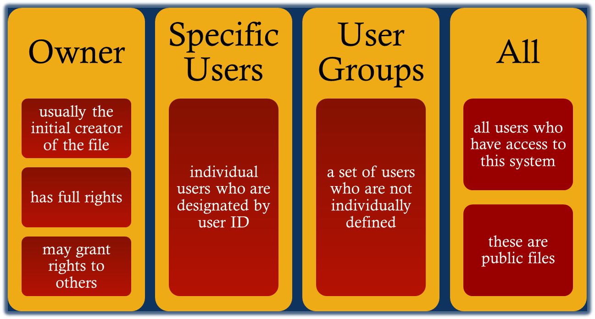
User Access Rights
Notes:
One user is designated as owner of a given file, usually the person who initially
created a file. The owner has all of the access rights listed previously and may grant
rights to others. Access can be provided to different classes of users:
• Specific user: Individual users who are designated by user ID
• User groups: A set of users who are not individually defined. The system must
have some way of keeping track of the membership of user groups.
• All: All users who have access to this system. These are public files.
‹#›

Slide 36

Record Blocking
Fixed-Length Blocking – fixed-length records are used, and an integral number of records (or bytes) are stored in a block Internal fragmentation – unused space at the end of each block for records, but not for bytes
Blocks are the unit of I/O with secondary storage
for I/O to be performed records must be organized as blocks
Given the size of a block, three methods of blocking can be used:
Variable-Length Spanned Blocking – variable-length records are packed into blocks with no unused space
Variable-Length Unspanned Blocking – variable-length records are used, but spanning is not
Notes:
As indicated in Figure 12.2 , records are the logical unit of access of a structured file,
whereas blocks are the unit of I/O with secondary storage. For I/O to be performed,
records must be organized as blocks.
There are several issues to consider. First, should blocks be of fixed or variable
length? On most systems, blocks are of fixed length. This simplifies I/O, buffer
allocation in main memory, and the organization of blocks on secondary storage.
Second, what should the relative size of a block be compared to the average record
size? The trade-off is this: The larger the block, the more records that are passed
in one I/O operation. If a file is being processed or searched sequentially, this is an
advantage, because the number of I/O operations is reduced by using larger blocks,
thus speeding up processing. On the other hand, if records are being accessed randomly
and no particular locality of reference is observed, then larger blocks result in
the unnecessary transfer of unused records. However, combining the frequency of
sequential operations with the potential for locality of reference, we can say that the
I/O transfer time is reduced by using larger blocks. The competing concern is that
larger blocks require larger I/O buffers, making buffer management more difficult.
Given the size of a block, there are three methods of blocking that can be used:
• Fixed blocking: Fixed-length records are used, and an integral number of
records are stored in a block. There may be unused space at the end of each
block. This is referred to as internal fragmentation.
• Variable-length spanned blocking: Variable-length records are used and are
packed into blocks with no unused space. Thus, some records must span two
blocks, with the continuation indicated by a pointer to the successor block.
Variable-length unspanned blocking: Variable-length records are used, but
spanning is not employed. There is wasted space in most blocks because of the
inability to use the remainder of a block if the next record is larger than the
remaining unused space.
‹#›

Slide 37

File Allocation
Disks are divided into physical blocks (sectors on a track)
Files are divided into logical blocks (subdivisions of the file)
Logical block size = some multiple of a physical block size
The operating system or file management system is responsible for allocating blocks to files
Space is allocated to a file as one or more portions (contiguous set of allocated disk blocks). A portion is the logical block size
File allocation table (FAT)
data structure used to keep track of the portions assigned to a file
Notes:
On secondary storage, a file consists of a collection of blocks. The operating system
or file management system is responsible for allocating blocks to files. This raises
two management issues. First, space on secondary storage must be allocated to files,
and second, it is necessary to keep track of the space available for allocation. We
will see that these two tasks are related; that is, the approach taken for file allocation
may influence the approach taken for free space management. Further, we will
see that there is an interaction between file structure and allocation policy.
We begin this section by looking at alternatives for file allocation on a single
disk. Then we look at the issue of free space management, and finally we discuss
reliability.
File Allocation
Several issues are involved in file allocation:
1. When a new file is created, is the maximum space required for the file allocated
at once?
2. Space is allocated to a file as one or more contiguous units, which we shall
refer to as portions. That is, a portion is a contiguous set of allocated blocks.
The size of a portion can range from a single block to the entire file. What size
of portion should be used for file allocation?
3. What sort of data structure or table is used to keep track of the portions
assigned to a file? An example of such a structure is a file allocation table
(FAT) , found on DOS and some other systems.
‹#›

Slide 38
Preallocation vs Dynamic Allocation
A preallocation policy requires that the maximum size of a file be declared at the time of the file creation request
For many applications it is difficult to estimate reliably the maximum potential size of the file
tends to be wasteful because users and application programmers tend to overestimate size
Dynamic allocation allocates space to a file in portions as needed
Notes:
A preallocation policy requires
that the maximum size of a file be declared at the time of the file creation request.
In a number of cases, such as program compilations, the production of summary
data files, or the transfer of a file from another system over a communications
network, this value can be reliably estimated. However, for many applications, it
is difficult if not impossible to estimate reliably the maximum potential size of the
file. In those cases, users and application programmers would tend to overestimate
file size so as not to run out of space. This clearly is wasteful from the point of view
of secondary storage allocation. Thus, there are advantages to the use of dynamic
allocation, which allocates space to a file in portions as needed.
‹#›

Slide 39

Portion Size
In choosing a portion size there is a trade-off between efficiency from the point of view of a single file versus overall system efficiency
Items to be considered:
contiguity of space increases performance, especially for Retrieve_Next operations, and greatly for transactions running in a transaction-oriented operating system
having a large number of small portions increases the size of tables needed to manage the allocation information
having fixed-size portions simplifies the reallocation of space
having variable-size or small fixed-size portions minimizes waste of unused storage due to overallocation
Notes:
The second issue listed is that of the size of the portion allocated to a
file. At one extreme, a portion large enough to hold the entire file is allocated. At the
other extreme, space on the disk is allocated one block at a time. In choosing a portion
size, there is a trade-off between efficiency from the point of view of a single file versus
overall system efficiency. [WIED87] lists four items to be considered in the trade-off:
1. Contiguity of space increases performance, especially for Retrieve_Next
operations, and greatly for transactions running in a transaction-oriented
operating system.
2. Having a large number of small portions increases the size of tables needed to
manage the allocation information.
3. Having fixed-size portions (e.g., blocks) simplifies the reallocation of space.
4. Having variable-size or small fixed-size portions minimizes waste of unused
storage due to overallocation.
‹#›

Slide 40

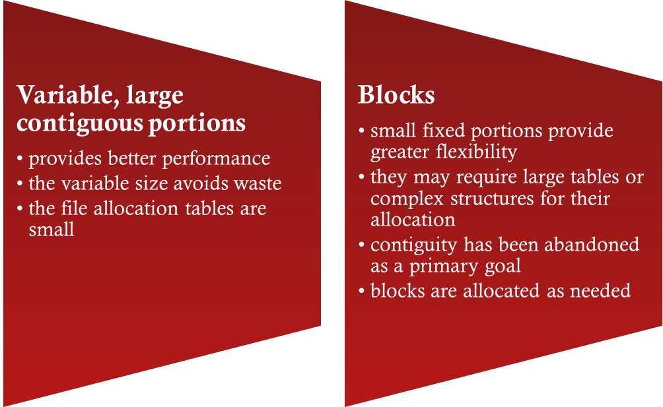

Summarizing the Alternatives
Two major alternatives:
Notes:
Of course, these items interact and must be considered together. The result is
that there are two major alternatives:
• Variable, large contiguous portions: This will provide better performance. The
variable size avoids waste, and the file allocation tables are small. However,
space is hard to reuse.
• Blocks : Small fixed portions provide greater flexibility. They may require
large tables or complex structures for their allocation. Contiguity has been
abandoned as a primary goal; blocks are allocated as needed.
Either option is compatible with preallocation or dynamic allocation. In
the case of variable, large contiguous portions, a file is preallocated one contiguous
group of blocks. This eliminates the need for a file allocation table; all that is
required is a pointer to the first block and the number of blocks allocated. In the
case of blocks, all of the portions required are allocated at one time. This means that
the file allocation table for the file will remain of fixed size, because the number of
blocks allocated is fixed.
With variable-size portions, we need to be concerned with the fragmentation
of free space. This issue was faced when we considered partitioned main memory in
Chapter 7 . The following are possible alternative strategies:
• First fit: Choose the first unused contiguous group of blocks of sufficient size
from a free block list.
• Best fit: Choose the smallest unused group that is of sufficient size.
• Nearest fit: Choose the unused group of sufficient size that is closest to the
previous allocation for the file to increase locality.
It is not clear which strategy is best. The difficulty in modeling alternative
strategies is that so many factors interact, including types of files, pattern of file
access, degree of multiprogramming, other performance factors in the system, disk
caching, disk scheduling, and so on.
‹#›

Slide 41
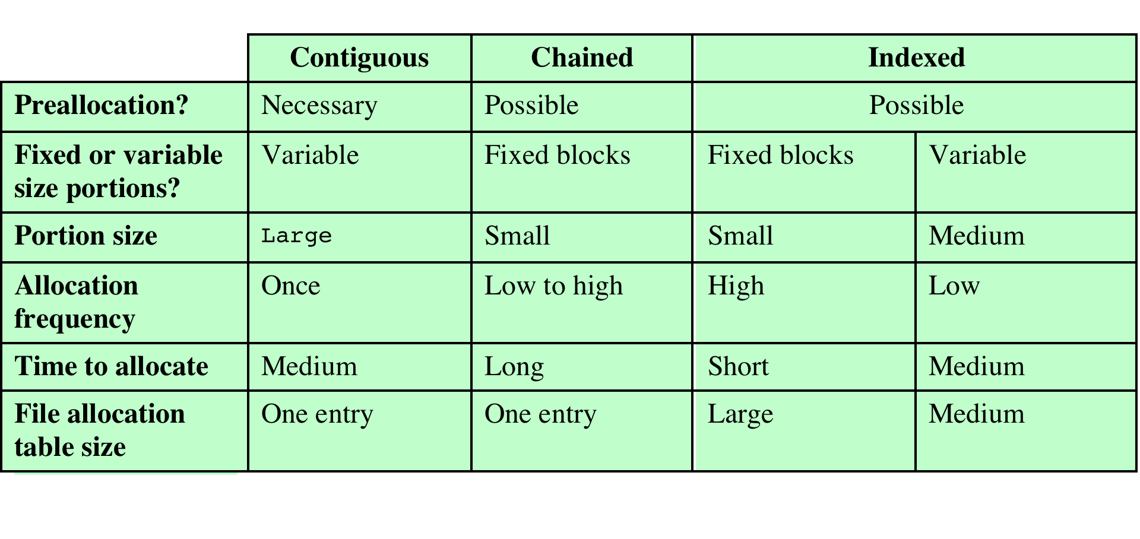
Table 12.3 File Allocation Methods
Notes:
Table 12.3 File Allocation Methods
Having looked at the issues of preallocation versus
dynamic allocation and portion size, we are in a position to consider specific file
allocation methods. Three methods are in common use: contiguous, chained, and
indexed. Table 12.3 summarizes some of the characteristics of each method.
‹#›

Slide 42
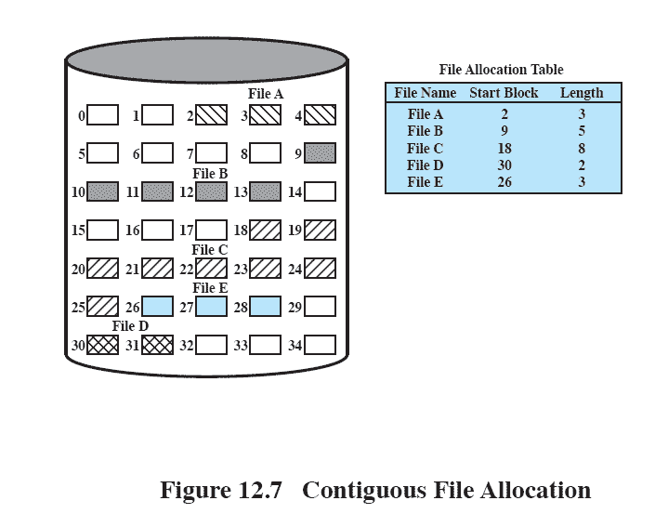
Contiguous File Allocation
A single contiguous set of blocks is allocated to a file at the time of file creation
Preallocation strategy using variable-size portions
Is the best from the point of view of the individual sequential file
12.9
Notes:
With contiguous allocation , a single contiguous set of blocks is allocated to a
file at the time of file creation ( Figure 12.9 ). Thus, this is a preallocation strategy,
using variable-size portions. The file allocation table needs just a single entry for
each file, showing the starting block and the length of the file. Contiguous allocation
is the best from the point of view of the individual sequential file. Multiple blocks
can be read in at a time to improve I/O performance for sequential processing. It is
also easy to retrieve a single block. For example, if a file starts at block b , and the
i th block of the file is wanted, its location on secondary storage is simply b + i – 1.
Contiguous allocation presents some problems. External fragmentation will occur,
making it difficult to find contiguous blocks of space of sufficient length.
‹#›

Slide 43
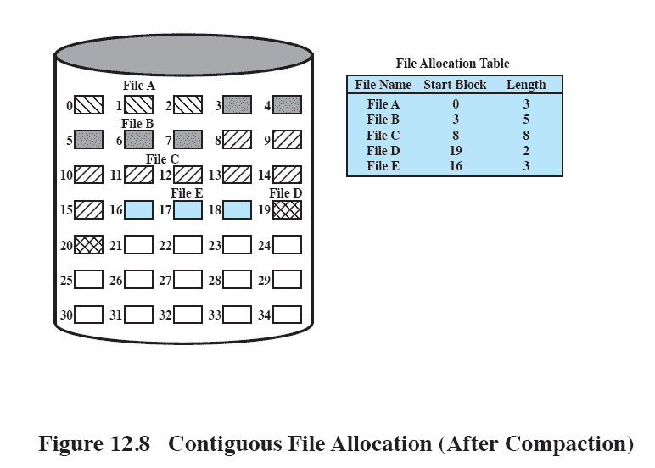
After Compaction
Figure 12.10 Contiguous File Allocation (After Compaction)
Notes:
From time to time, it will be necessary to perform a compaction algorithm to free up additional
space on the disk ( Figure 12.10 ). Also, with preallocation, it is necessary to declare
the size of the file at the time of creation, with the problems mentioned earlier.
‹#›

Slide 44
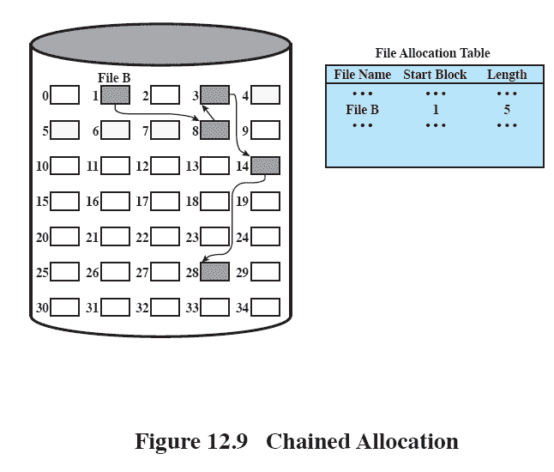
Chained Allocation
Allocation is on an individual block basis
Each block contains a pointer to the next block in the chain
The file allocation table needs just a single entry for each file
No external fragmentation to worry about
Better for sequential files
12.11
Notes:
At the opposite extreme from contiguous allocation is chained allocation
( Figure 12.11 ). Typically, allocation is on an individual block basis. Each block contains
a pointer to the next block in the chain. Again, the file allocation table needs
just a single entry for each file, showing the starting block and the length of the
file. Although preallocation is possible, it is more common simply to allocate blocks
as needed. The selection of blocks is now a simple matter: Any free block can be
added to a chain. There is no external fragmentation to worry about because only
one block at a time is needed. This type of physical organization is best suited to
sequential files that are to be processed sequentially. To select an individual block
of a file requires tracing through the chain to the desired block.
‹#›

Slide 45
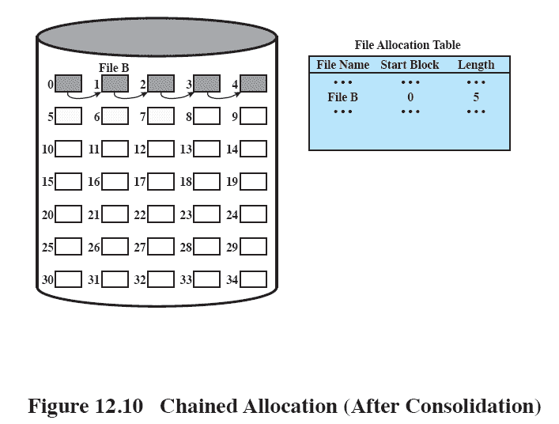
Chained Allocation After Consolidation
12.12
Notes:
One consequence of chaining, as described so far, is that there is no accommodation
of the principle of locality. Thus, if it is necessary to bring in several blocks of
a file at a time, as in sequential processing, then a series of accesses to different parts
of the disk are required. This is perhaps a more significant effect on a single-user
system but may also be of concern on a shared system. To overcome this problem,
some systems periodically consolidate files ( Figure 12.12 ).
‹#›

Slide 46
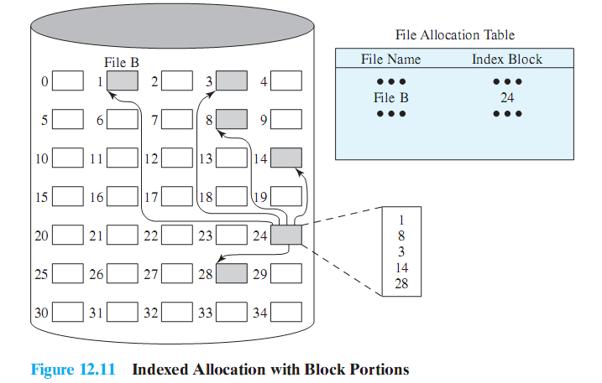
Indexed Allocation with Block Portions
12.13
Notes:
Indexed allocation addresses many of the problems of contiguous and chained
allocation. In this case, the file allocation table contains a separate one-level index for
each file; the index has one entry for each portion allocated to the file. Typically, the
file indexes are not physically stored as part of the file allocation table. Rather, the
file index for a file is kept in a separate block, and the entry for the file in the file allocation
table points to that block. Allocation may be on the basis of either fixed-size
blocks ( Figure 12.13 ) or variable-size portions ( Figure 12.14 ). Allocation by blocks
eliminates external fragmentation, whereas allocation by variable-size portions
improves locality. In either case, file consolidation may be done from time to time.
File consolidation reduces the size of the index in the case of variable-size portions,
but not in the case of block allocation. Indexed allocation supports both sequential
and direct access to the file and thus is the most popular form of file allocation.
‹#›

Slide 47
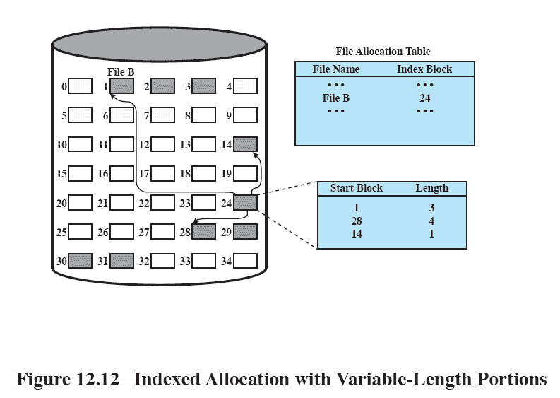
Indexed Allocation with Variable Length Portions
12.14
Notes:
Figure 12.14 Indexed allocation with Variable-Length Portions
‹#›

Slide 48
Access Control
In a system with multiple users, it’s important to protect one user’s objects (files, directories) from other users.
Two levels of protections:
Logon verifications: guarantees you have the right to log onto the system
Access determination: guarantees you have permission to access a specific object
Access matrix, access lists, capability lists: techniques for determining access rights.

Slide 49
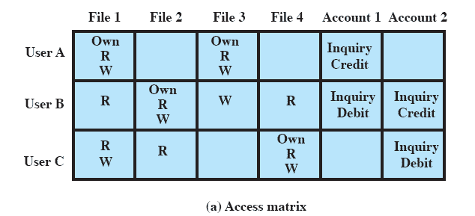
Access Matrix
The basic elements are:
subject – an entity capable of accessing objects
object – anything to which access is controlled
access right – the way in which an object is accessed by a subject
Notes:
Following successful logon, the user has been granted access to one or a set of hosts
and applications. This is generally not sufficient for a system that includes sensitive
data in its database. Through the user–access control procedure, a user can be
identified to the system. Associated with each user, there can be a profile that specifies
permissible operations and file accesses. The operating system can then enforce
rules based on the user profile. The database management system, however, must
control access to specific records or even portions of records. For example, it may
be permissible for anyone in administration to obtain a list of company personnel,
but only selected individuals may have access to salary information. The issue is
more than just a matter of level of detail. Whereas the operating system may grant
a user permission to access a file or use an application, following which there are
no further security checks, the database management system must make a decision
on each individual access attempt. That decision will depend not only on the user’s
identity but also on the specific parts of the data being accessed and even on the
information already divulged to the user.
A general model of access control as exercised by a file or database management
system is that of an access matrix ( Figure 12.15a , based on a figure in
[SAND94]). The basic elements of the model are as follows:
• Subject: An entity capable of accessing objects. Generally, the concept of subject
equates with that of process. Any user or application actually gains access
to an object by means of a process that represents that user or application.
• Object: Anything to which access is controlled. Examples include files, portions
of files, programs, segments of memory, and software objects (e.g., Java objects).
• Access right: The way in which an object is accessed by a subject. Examples
are read, write, execute, and functions in software objects.
One dimension of the matrix consists of identified subjects that may attempt
data access. Typically, this list will consist of individual users or user groups, although
access could be controlled for terminals, hosts, or applications instead of or in addition
to users. The other dimension lists the objects that may be accessed. At the greatest
level of detail, objects may be individual data fields. More aggregate groupings,
such as records, files, or even the entire database, may also be objects in the matrix.
Each entry in the matrix indicates the access rights of that subject for that object.
‹#›

Slide 50
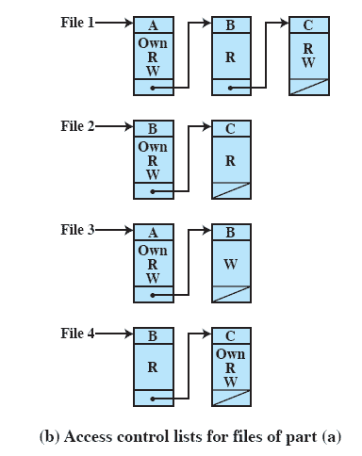
Access Control Lists
A matrix may be decomposed by columns, yielding access control lists
The access control list lists users and their permitted access rights
Notes:
In practice, an access matrix is usually sparse and is implemented by decomposition
in one of two ways. The matrix may be decomposed by columns, yielding
access control lists ( Figure 12.15b ). Thus for each object, an access control list lists
users and their permitted access rights. The access control list may contain a default,
or public, entry. This allows users that are not explicitly listed as having special rights
to have a default set of rights. Elements of the list may include individual users as
well as groups of users.
‹#›

Slide 51
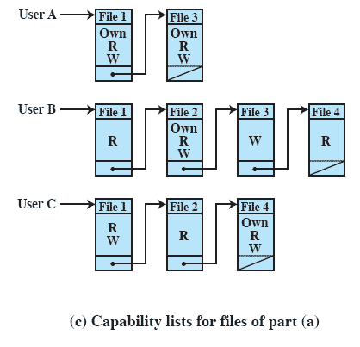
Capability Lists
Decomposition by rows yields capability tickets
A capability ticket specifies authorized objects and operations for a user
Notes:
Decomposition by rows yields capability tickets ( Figure 12.15c ). A capability
ticket specifies authorized objects and operations for a user. Each user has a
number of tickets and may be authorized to loan or give them to others. Because
tickets may be dispersed around the system, they present a greater security problem
than access control lists. In particular, the ticket must be unforgeable. One way to
accomplish this is to have the operating system hold all tickets on behalf of users.
These tickets would have to be held in a region of memory inaccessible to users.
‹#›

Slide 52
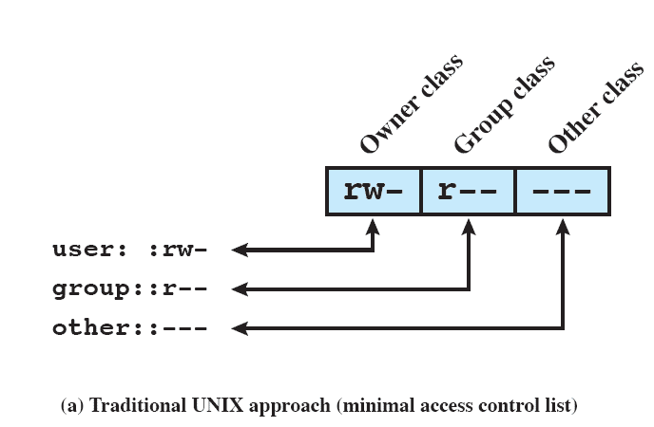

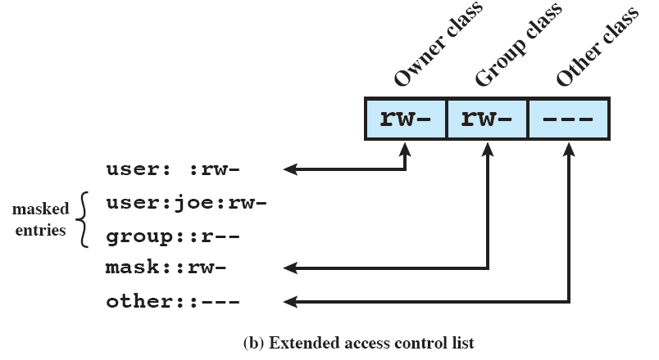

UNIX File Access Control
Notes:
Most UNIX systems depend on, or at least are based on, the file access control
scheme introduced with the early versions of UNIX. Each UNIX user is assigned a
unique user identification number (user ID). A user is also a member of a primary
group, and possibly a number of other groups, each identified by a group ID. When
a file is created, it is designated as owned by a particular user and marked with that
user’s ID. It also belongs to a specific group, which initially is either its creator’s
primary group, or the group of its parent directory if that directory has SetGID
permission set. Associated with each file is a set of 12 protection bits. The owner ID,
group ID, and protection bits are part of the file’s inode.
Nine of the protection bits specify read, write, and execute permission for the
owner of the file, other members of the group to which this file belongs, and all
other users. These form a hierarchy of owner, group, and all others, with the highest
relevant set of permissions being used. Figure 12.18a shows an example in which the
file owner has read and write access; all other members of the file’s group have read
access, and users outside the group have no access rights to the file. When applied to
a directory, the read and write bits grant the right to list and to create/rename/delete
files in the directory. The execute bit grants the right to search the directory for a
component of a filename.
The remaining three bits define special additional behavior for files or directories.
Two of these are the “set user ID” (SetUID) and “set group ID” (SetGID)
permissions. If these are set on an executable file, the operating system functions as
follows. When a user (with execute privileges for this file) executes the file, the system
temporarily allocates the rights of the user’s ID of the file creator, or the file’s
group, respectively, to those of the user executing the file. These are known as the
“effective user ID” and “effective group ID” and are used in addition to the “real
user ID” and “real group ID” of the executing user when making access control
decisions for this program. This change is only effective while the program is being
executed. This feature enables the creation and use of privileged programs that may
use files normally inaccessible to other users. It enables users to access certain files
in a controlled fashion. Alternatively, when applied to a directory, the SetGID permission
indicates that newly created files will inherit the group of this directory. The
SetUID permission is ignored.
The final permission bit is the “Sticky” bit. When set on a file, this originally
indicated that the system should retain the file contents in memory following execution.
This is no longer used. When applied to a directory, though, it specifies that
only the owner of any file in the directory can rename, move, or delete that file. This
is useful for managing files in shared temporary directories.
One particular user ID is designated as “superuser.” The superuser is exempt
from the usual file access control constraints and has systemwide access. Any
program that is owned by, and SetUID to, the “superuser” potentially grants unrestricted
access to the system to any user executing that program. Hence, great care
is needed when writing such programs.
This access scheme is adequate when file access requirements align with users
and a modest number of groups of users. For example, suppose a user wants to give
read access for file X to users A and B and read access for file Y to users B and C.
We would need at least two user groups, and user B would need to belong to both
groups in order to access the two files. However, if there are a large number of
different groupings of users requiring a range of access rights to different files, then
a very large number of groups may be needed to provide this. This rapidly becomes
unwieldy and difficult to manage, even if possible at all. 6 One way to overcome this
problem is to use access control lists, which are provided in most modern UNIX
systems.
A final point to note is that the traditional UNIX file access control scheme
implements a simple protection domain structure. A domain is associated with the
user, and switching the domain corresponds to changing the user ID temporarily.
‹#›

Slide 53
Summary
A file management system:
is a set of system software that provides services to users and applications in the use of files
is typically viewed as a system service that is served by the operating system
Files:
consist of a collection of records
if a file is primarily to be processed as a whole, a sequential file organization is the simplest and most appropriate
if sequential access is needed but random access to individual file is also desired, an indexed sequential file may give the best performance
if access to the file is principally at random, then an indexed file or hashed file may be the most appropriate
directory service allows files to be organized in a hierarchical fashion
Some sort of blocking strategy is needed
Key function of file management scheme is the management of disk space
strategy for allocating disk blocks to a file
maintaining a disk allocation table indicating which blocks are free
Notes:
A file management system is a set of system software that provides services to users
and applications in the use of files, including file access, directory maintenance, and
access control. The file management system is typically viewed as a system service
that itself is served by the operating system, rather than being part of the operating
system itself. However, in any system, at least part of the file management function
is performed by the operating system.
A file consists of a collection of records. The way in which these records may
be accessed determines its logical organization, and to some extent its physical organization
on disk. If a file is primarily to be processed as a whole, then a sequential
file organization is the simplest and most appropriate. If sequential access is needed
but random access to individual file is also desired, then an indexed sequential file
may give the best performance. If access to the file is principally at random, then an
indexed file or hashed file may be the most appropriate.
Whatever file structure is chosen, a directory service is also needed. This
allows files to be organized in a hierarchical fashion. This organization is useful to
the user in keeping track of files and is useful to the file management system in providing
access control and other services to users.
File records, even when of fixed size, generally do not conform to the size of a
physical disk block. Accordingly, some sort of blocking strategy is needed. A tradeoff
among complexity, performance, and space utilization determines the blocking
strategy to be used.
A key function of any file management scheme is the management of disk
space. Part of this function is the strategy for allocating disk blocks to a file. A variety
of methods have been employed, and a variety of data structures have been used
to keep track of the allocation for each file. In addition, the space on disk that has
not been allocated must be managed. This latter function primarily consists of maintaining
a disk allocation table indicating which blocks are free.
‹#›

